Slide 1
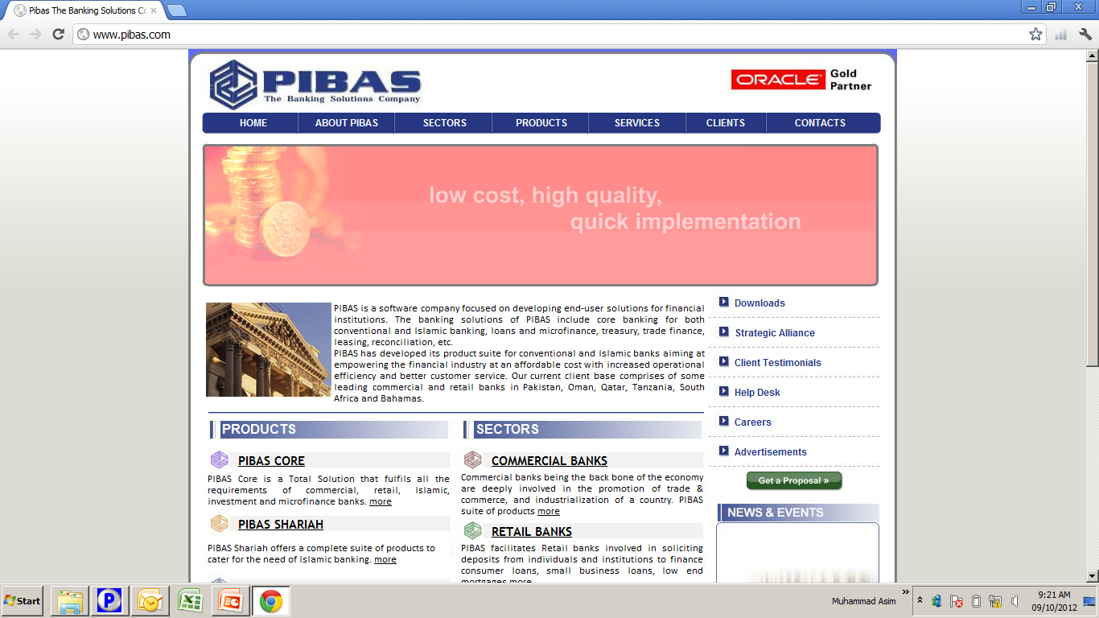
Security / User Maintenance
Security / User Maintenance
Important Note:
SME Data along with Bin will be used for this training.

Slide 2
Contents
Security / User Maintenance
PIBAS User Maintenance
Change Password
Role Permissions Maintenance
User Maintenance Report
User Profile Report
User Roles Report
Unlock User Utility
Audit Trail Report
User Restriction / Permission Maintenance

Slide 3
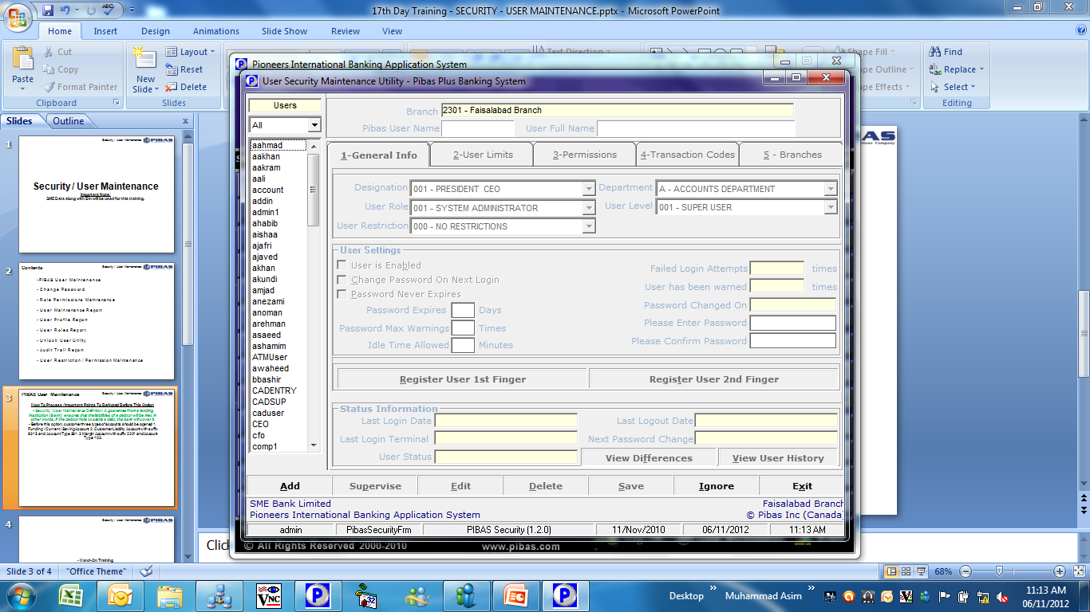
Security / User Maintenance
PIBAS User Maintenance
How To Process / Important Points To Be Noted Before This Option
This option provides a comprehensive options / rights / roles that can be delegated / revoke any time for a specific user. It contains the main tabs of General Information, User Limits, Permissions, Transactions codes and Branches
This option also requires supervision of an authorized user to supervise roles and rights
After deployment our system one super user can be created without supervision. So that both super users can create other users

Slide 4
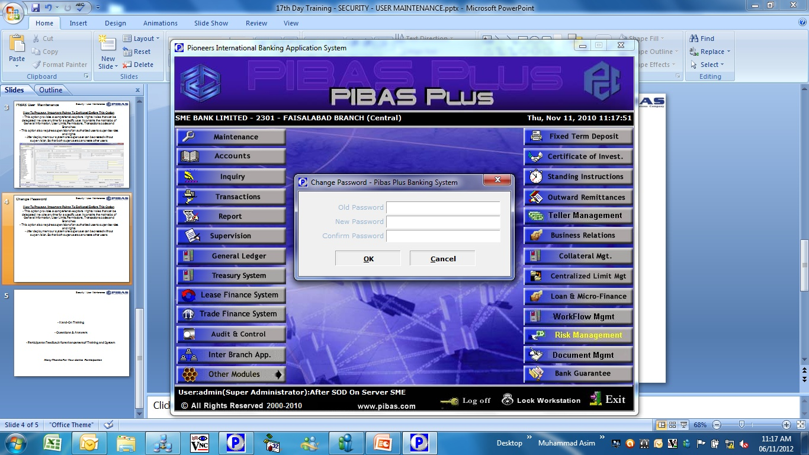
Security / User Maintenance
Change Password
How To Process / Important Points To Be Noted Before This Option
This option is delegated to every user to change his / her password at any time.
This option can also prompted automatically as per parameters given for any specific user.

Slide 5
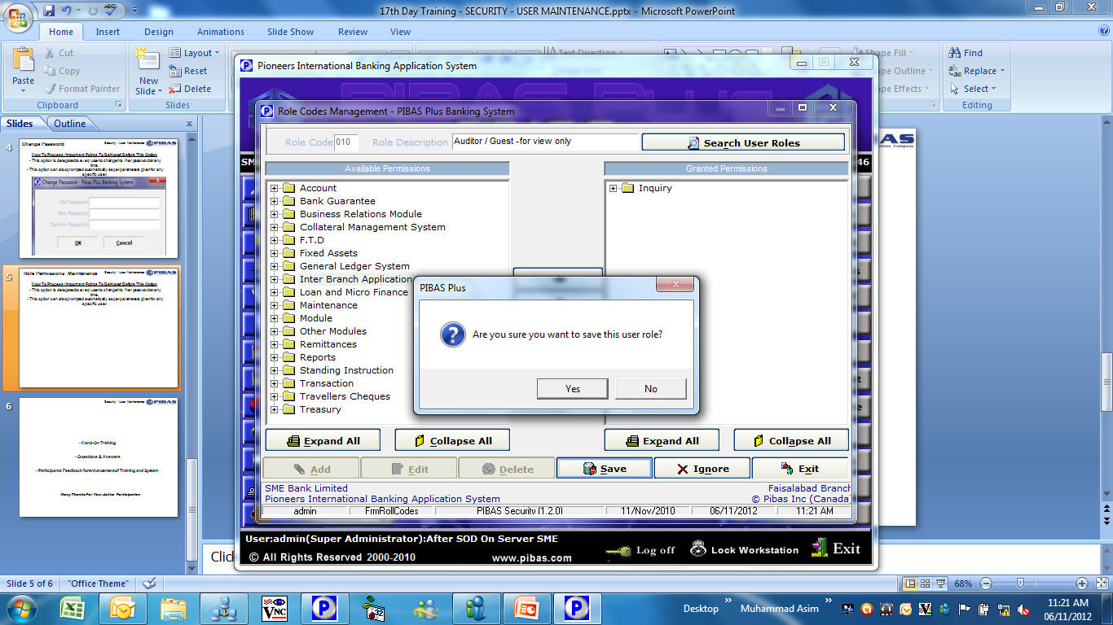
Security / User Maintenance
Role Permissions Maintenance
How To Process / Important Points To Be Noted Before This Option
Through this option, we can amend / create any user role with role code.
This is very useful option that saves the time of administrator while delegating rights to a user.

Slide 6
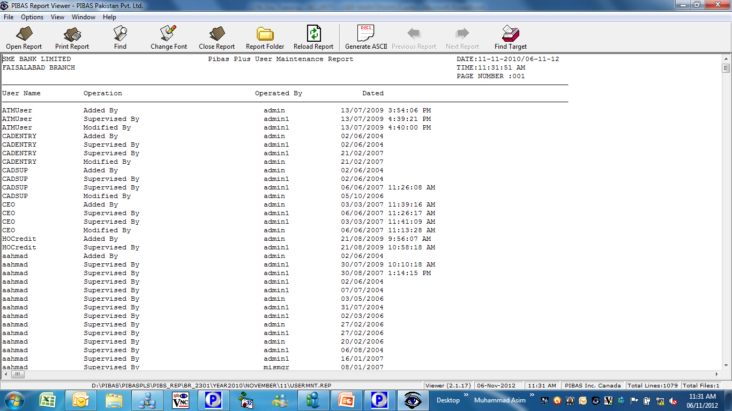
Security / User Maintenance
User Maintenance Report
How To Process / Important Points To Be Noted Before This Option
This report provides following important information

Slide 7
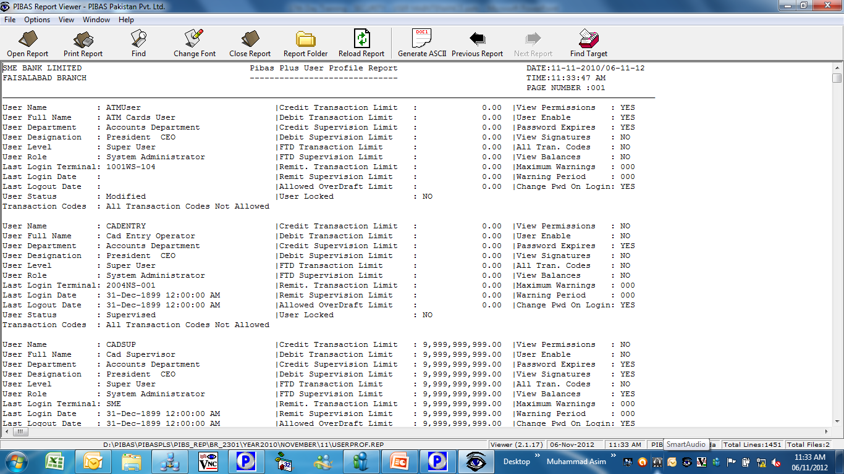
Security / User Maintenance
User Profile Report
How To Process / Important Points To Be Noted Before This Option
This report provides following important information

Slide 8
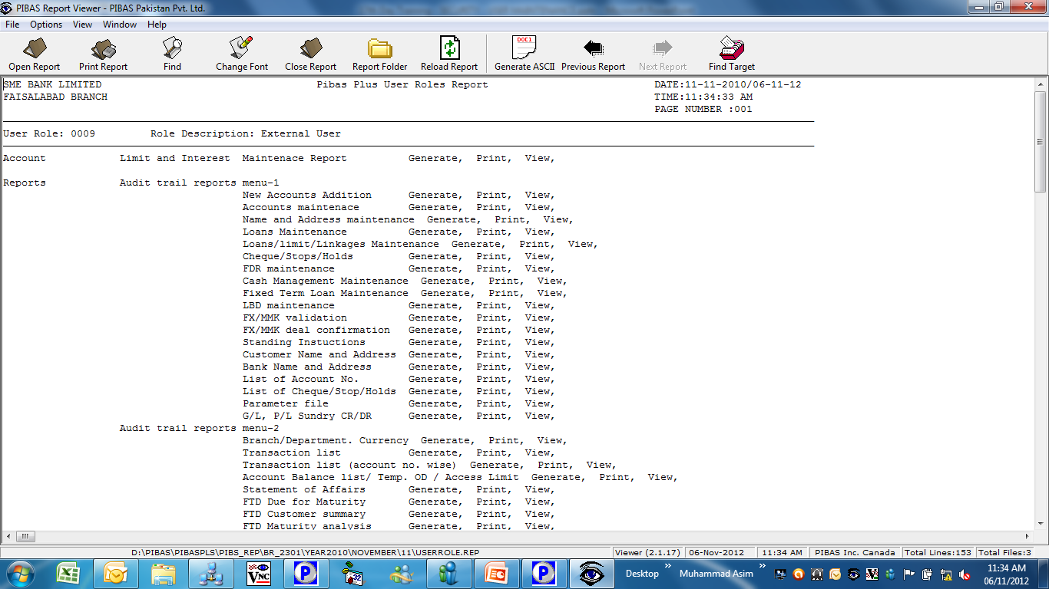
Security / User Maintenance
User Roles Report
How To Process / Important Points To Be Noted Before This Option
This report provides following important information

Slide 9
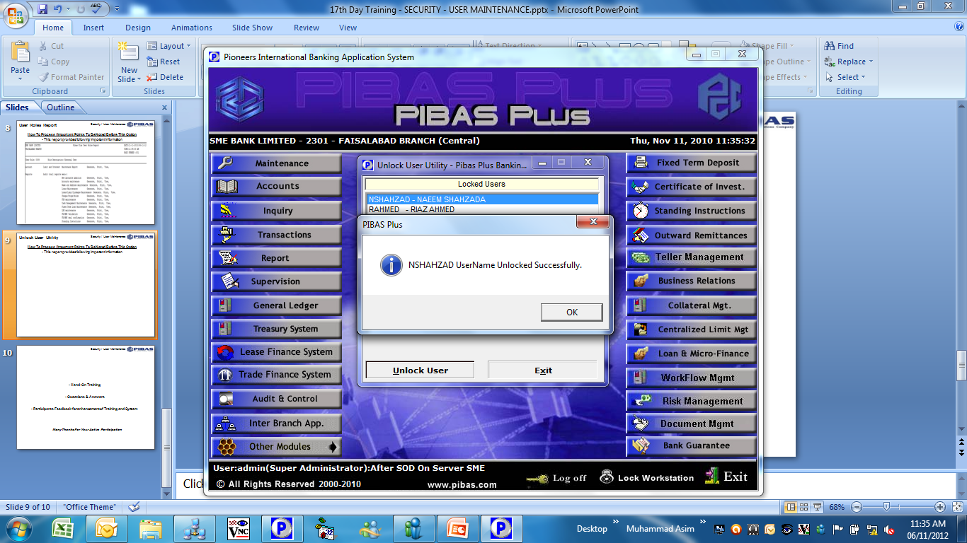
Security / User Maintenance
Unlock User Utility
How To Process / Important Points To Be Noted Before This Option
Through this option any locked user can be unlocked

Slide 10
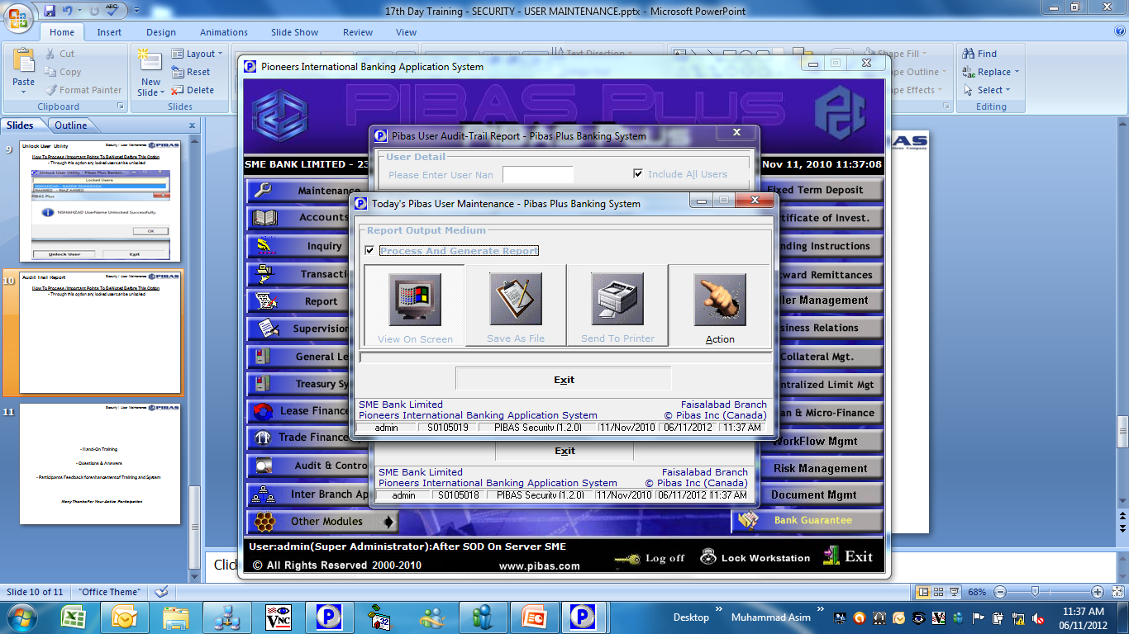
Security / User Maintenance
Audit Trail Report
How To Process / Important Points To Be Noted Before This Option
This report provides following important information

Slide 11
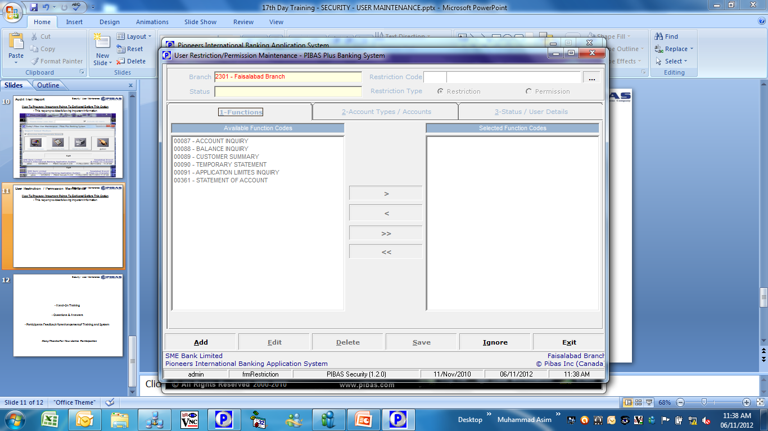
Security / User Maintenance
User Rest. / Perm. Maint.
How To Process / Important Points To Be Noted Before This Option
Through this option we can restrict / permit different functions, account types / accounts and status / user details etc.

Slide 12
Security / User Maintenance
Hand-On Training
Questions & Answers
Participants Feedback for enhancement of Training and System
Many Thanks For Your Active Participation

